Slide 1
Chapter 6
Surveys and Observations

Slide 2
Reminders
Chapter 6 Assignments due September 7th at 11:59 pm
  Ebook: Chapter 6
  InQuizitive: Chapter 6

Slide 3
Agenda
Surveys and Polls
Observational Research
Next time on PSY 270…

Slide 4
Construct Validity of Surveys and Polls
Survey/poll
Choosing question formats
Writing well-worded questions
Encouraging accurate responses

Slide 5

Surveys and Polls
Survey/poll
  A method of asking people questions face-to-face, on the phone, on written questionnaires, or online.
  Used interchangeably in this class

Slide 6
Choosing Question Formats
Open-ended questions
What do you think of this class?
Forced-choice format
Do you like this class so far? Yes or No
Likert scale
Degree of agreement
Semantic differential format
How difficult is this class?
Easy 1 2 3 4 5 Hard

Slide 7
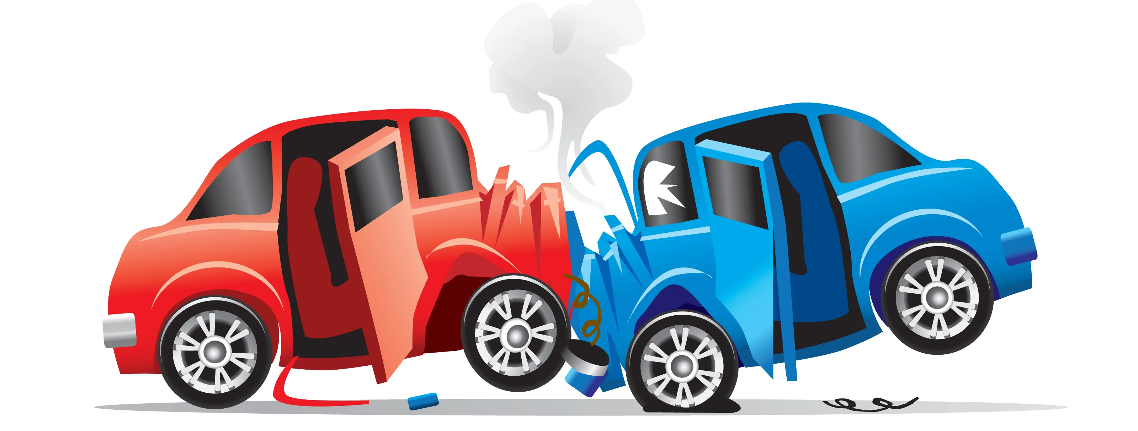
Writing Well-Worded Questions
How fast do you think the car was going?

Slide 8
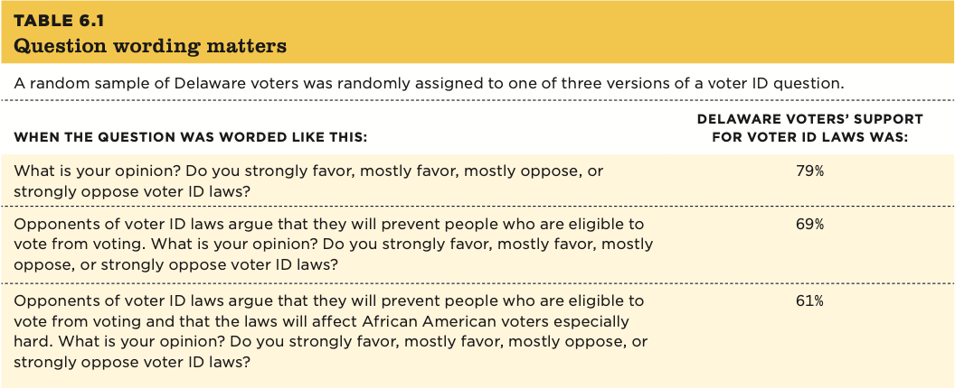
Writing Well-Worded Questions

Slide 9
Writing Well-Worded Questions
  Double-barreled question
  Do you enjoy swimming and wearing sunscreen?
  Negatively worded question
  People who do not drive with a suspended license should never be punished.
    Disagree 1 2 3 4 5 Agree

Slide 10
Writing Well-Worded Questions
  Leading question
    How much money do you waste every month not upgrading to our system?
  Question order and question context
    How concerned are you about the increase in violent crime in our community?
      Not concerned at all 1 2 3 4 5 Extremely concerned
    How safe you feel walking alone in your community at night?
      Very unsafe 1 2 3 4 5 Very safe

Slide 11
Writing Well-Worded Questions
Response options (and how you compare them) matter
Response options should be balanced
  Do you agree that Dr. Scheuler’s cats are adorable?
    1- THE MOST ADORABLE EVER, 2- Absolutely!, 3- Yes, 4- They’re okay, 5- I don’t like cats
Forced choice versus ranking:
  Vote for your preferred political candidate
  Rank your preference in political candidates

Slide 12
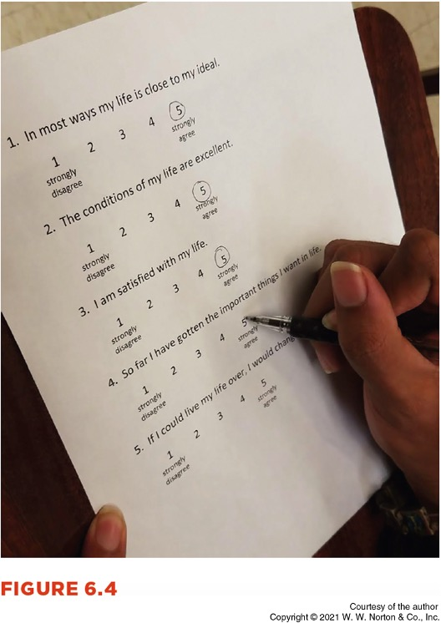
Encouraging Accurate Responses
People can give meaningful responses
Sometimes people use shortcuts
  Response sets
  Acquiescence (yea-saying)
  Fence sitting

Slide 13

Encouraging Accurate Responses
Trying to look good
  Socially desirable responding/faking good
  Faking bad
Self-reporting “more than they can know”
Self-reporting memories of events
Rating consumer products

Slide 14

Pew Research Center Methods 101: Question Wording
https://www.youtube.com/watch?v=eFzGdQrr2K8&amp;list=PLZ9z-Af5ISavJpPlvdMU4T-etIDOUmldk&amp;index=6&amp;t=0s

Slide 15
Observational Research

Slide 16
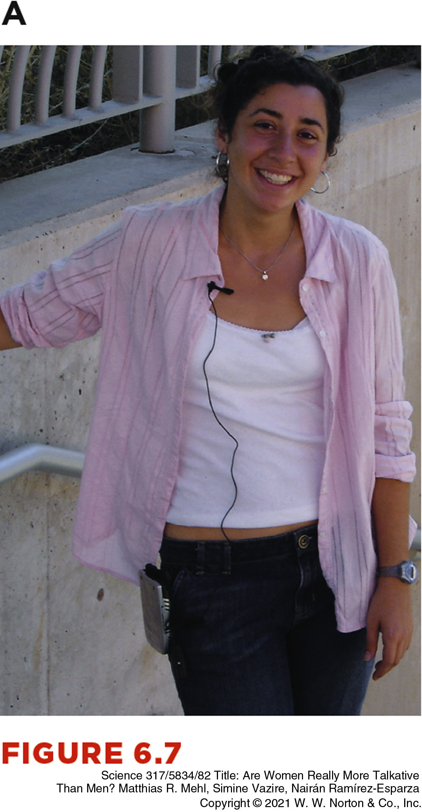
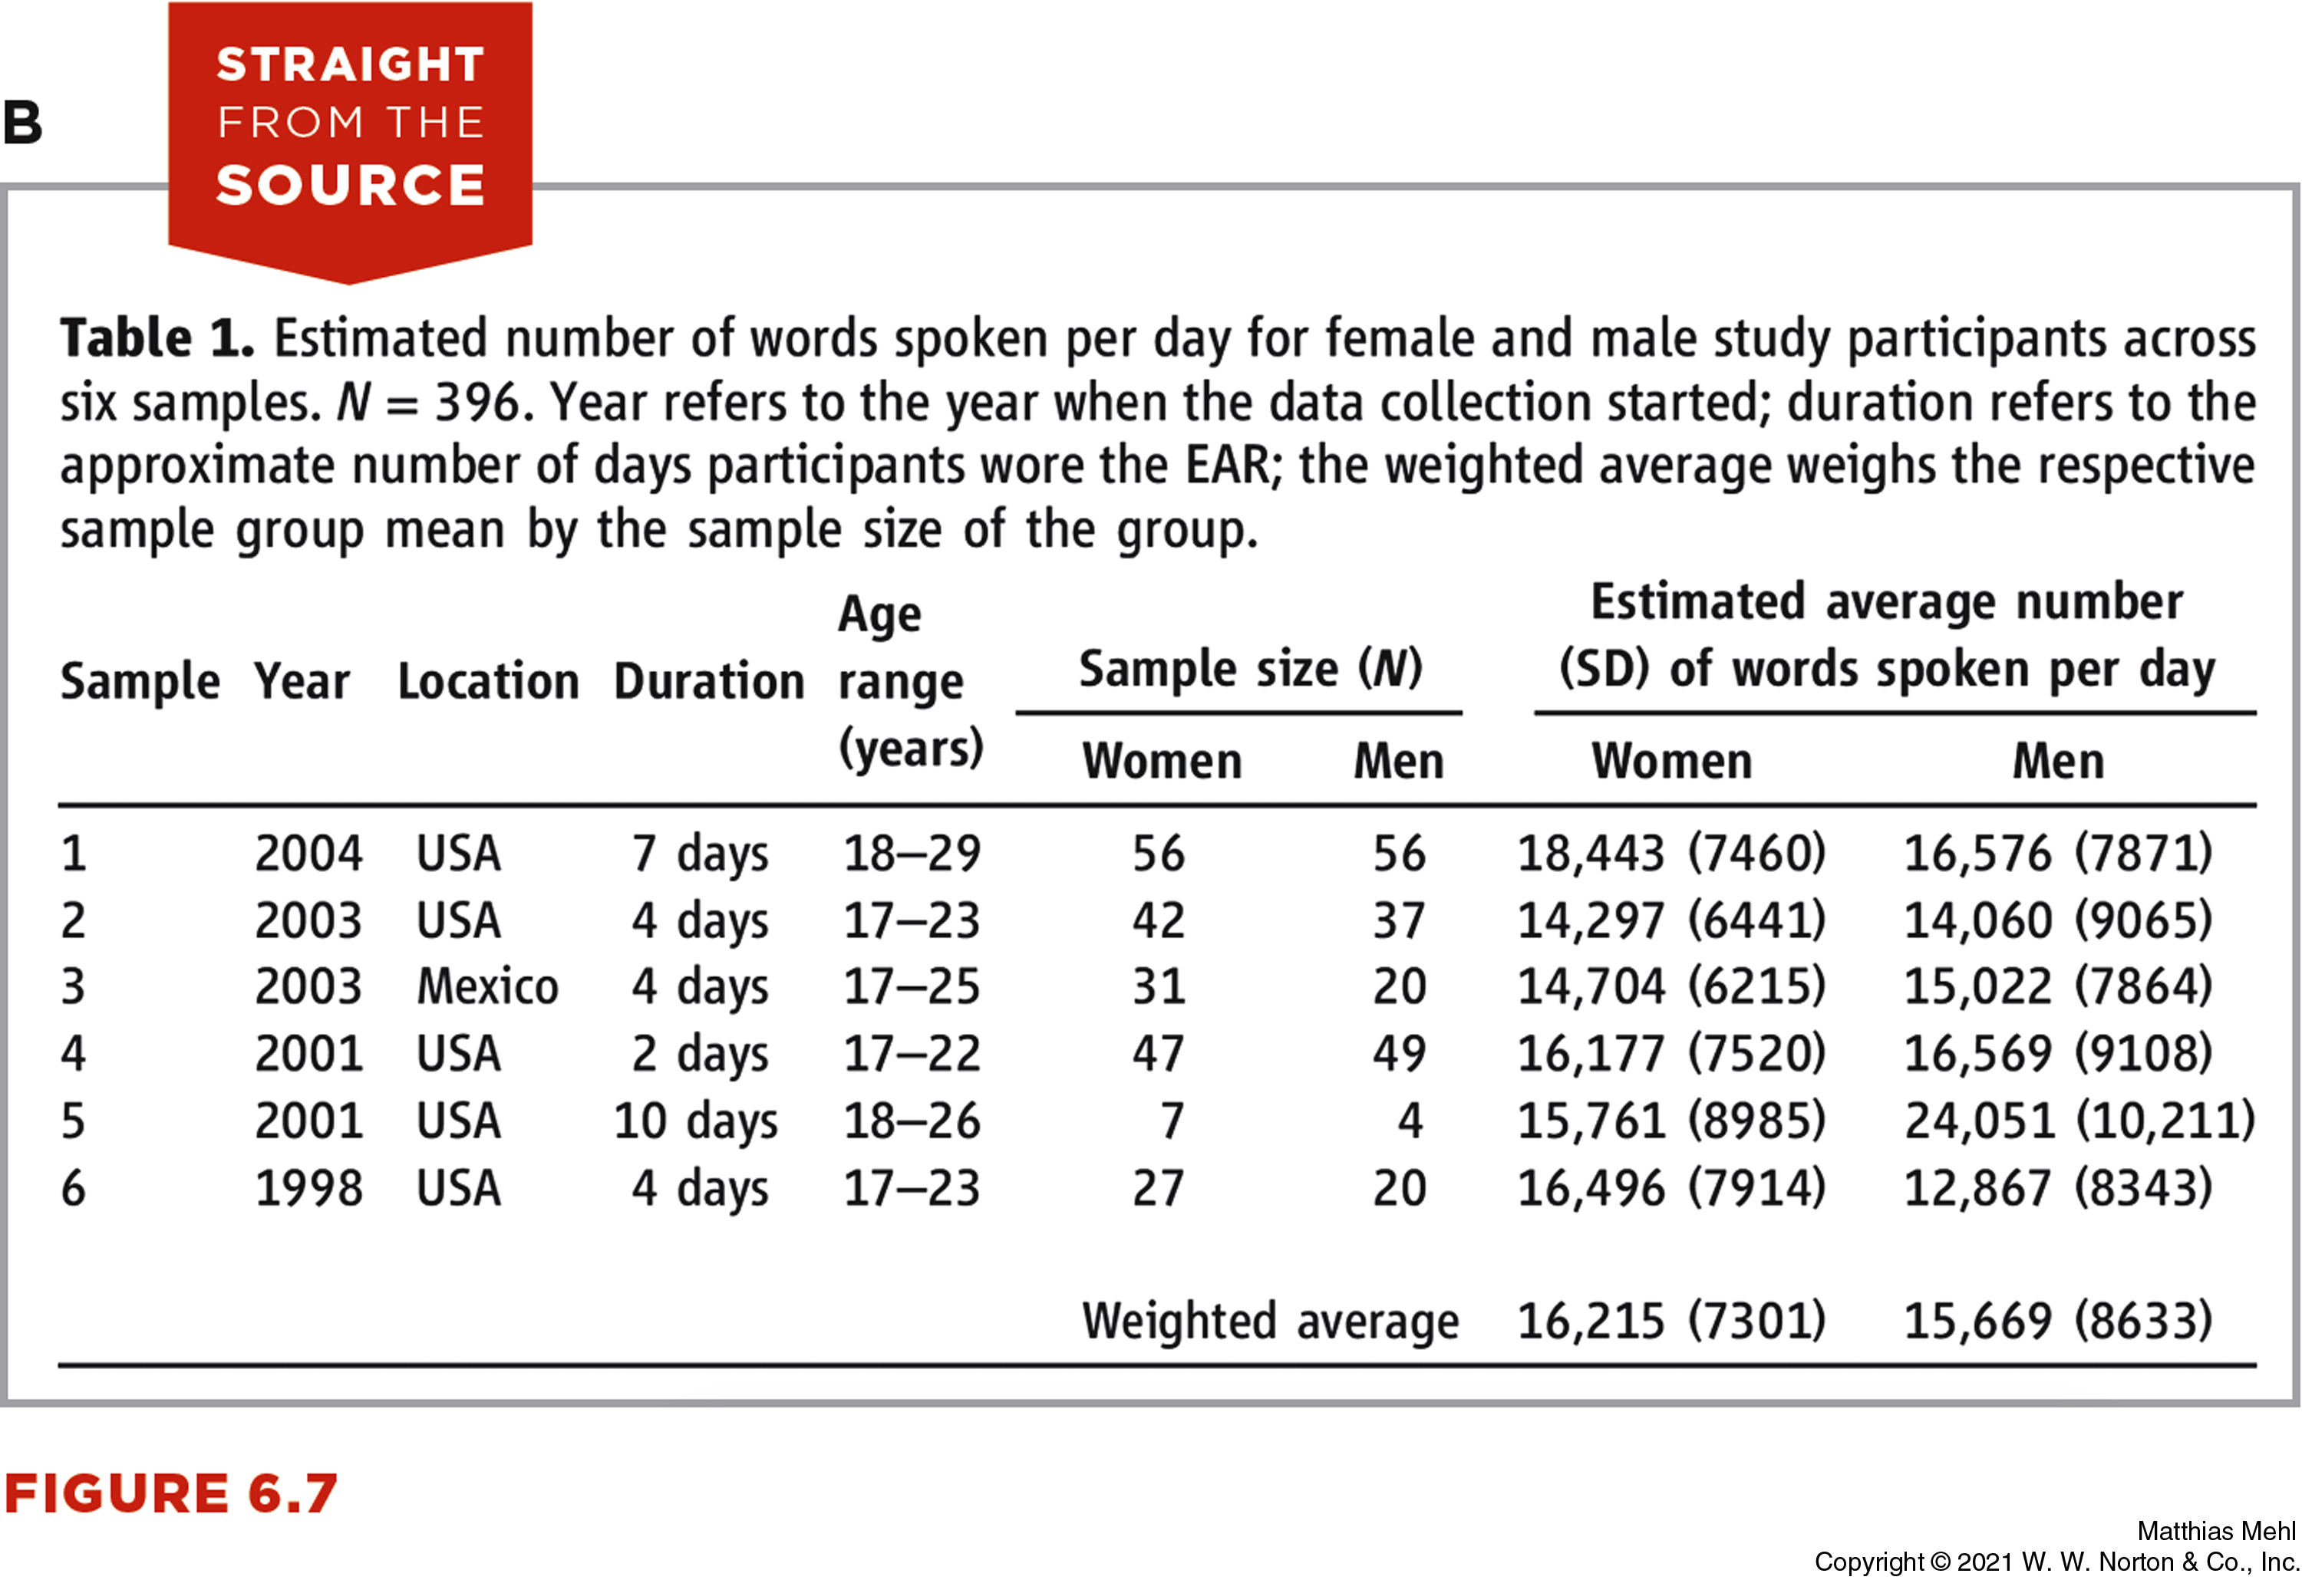
Construct Validity of Behavioral Observations
  Observational research
  Some claims based on observational data
  Observing how much people talk

Slide 17
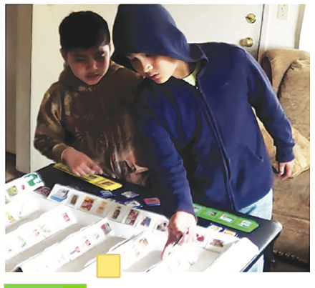
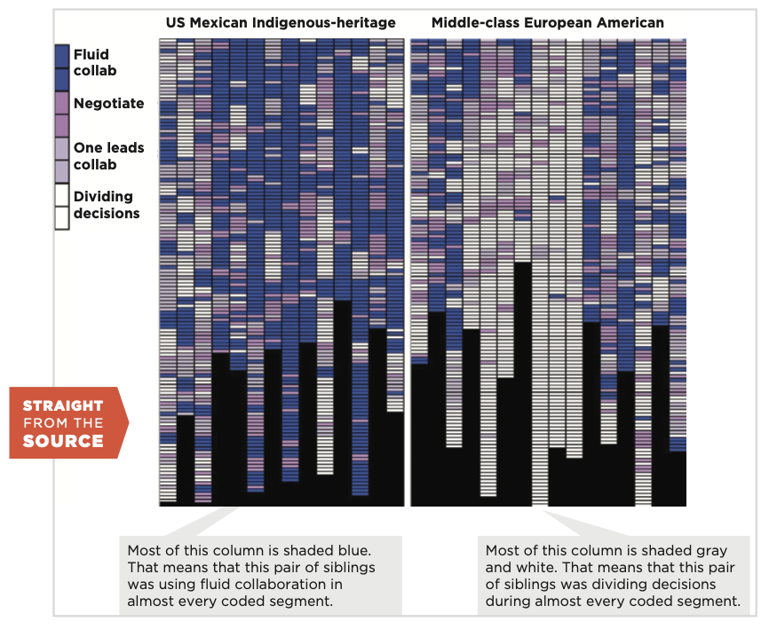
Some Claims Based on Observational Data
Observing where babies and caregivers look
Observing sibling interactions
Observations can be better than self-reports

Slide 18
Making Reliable and Valid Observations
Observer bias – when observers see what they expect to see
What are some examples that you can think?

Slide 19
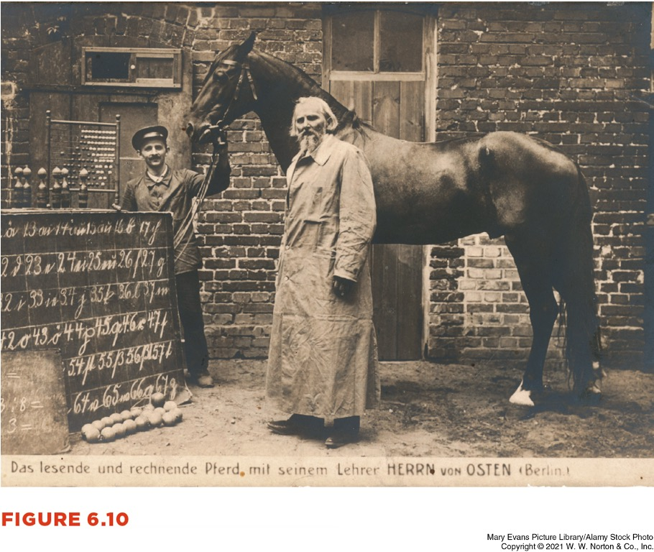
Making Reliable and Valid Observations
Observer effects: when participants confirm observer expectations
  Bright and dull rats
  Clever Hans

Slide 20
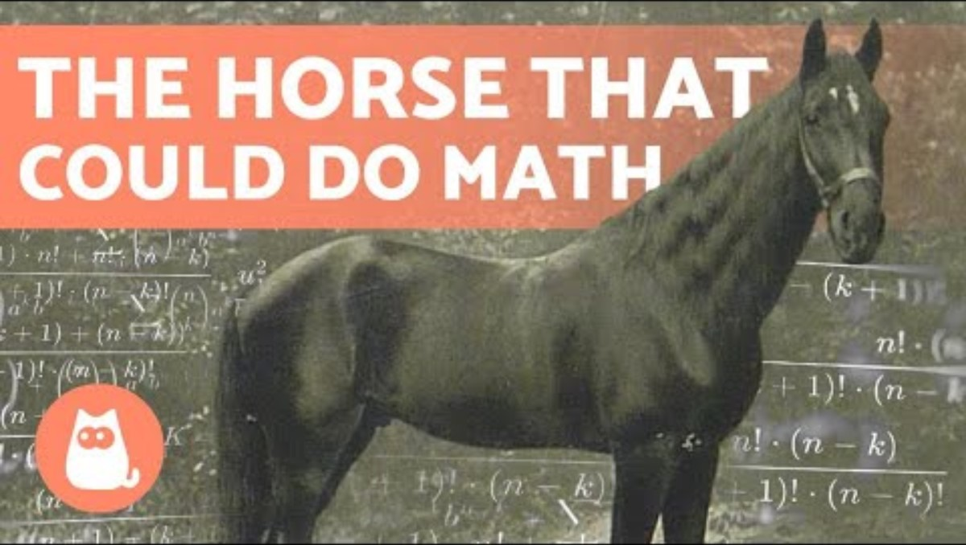
Clever Hans
https://www.youtube.com/watch?v=hAJlAuEo7Ac

Slide 21
Preventing Observer Bias and Observer Effects
Training
Masked design
  Single blind – when the participant does not know which condition they are in
  Double blind – when the researcher/ observer does not know which condition a participant is in
    Preferred for observational research

Slide 22
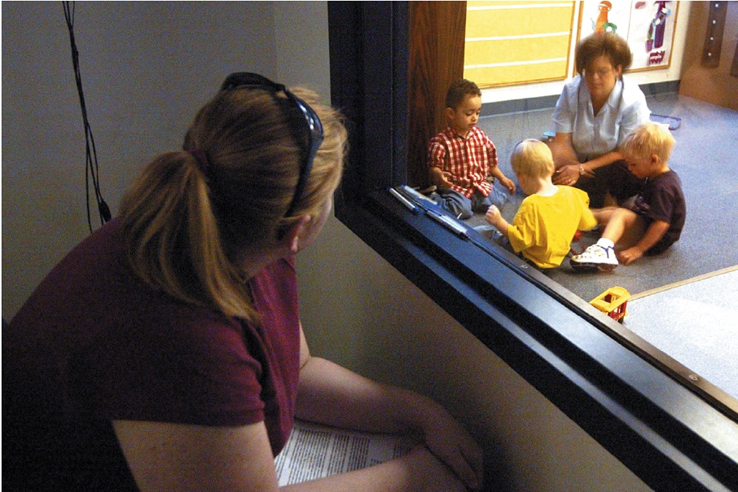
Reactivity: When Participants React to Being Watched
Reactivity – when people change their behavior in some way when they know that someone else is watching them
Solution 1: Blend in
  Unobtrusive observations
Solution 2: Wait it out
Solution 3: Measure the behavior’s results

Slide 23
Observing People Ethically
Is it ethical for researchers to observe the behaviors of others?
  Short answer: It depends.
  Public place/ setting?
    Ex: Online
  Types of behaviors?

Slide 24
Interviews
Interviews – qualitative method for learning information about a person on a deeper level
  Lots of information, but takes a lot of time
Informants – people who are experts on a topic
  Focus group – a group of informants
Techniques for getting in-depth information:
  Build rapport; Ask how, not why; Ask for informants opinions as experts/ emphasize your lack of knowledge; pretest your questions on others; normalize all answers; use participants own words; allow some silence; keep recording as you pack up

Slide 25
Next Time on PSY 270…
Before Next Class(es):
Read Chapter 6 and complete Ebook: Chapter 6 assignment
  Due 10/7 at 11:59 pm
Complete InQuizitive: Chapter 6
  Due 10/7 at 11:59 pm
Next Class:
Chapter 7: Sampling

